Slide 1
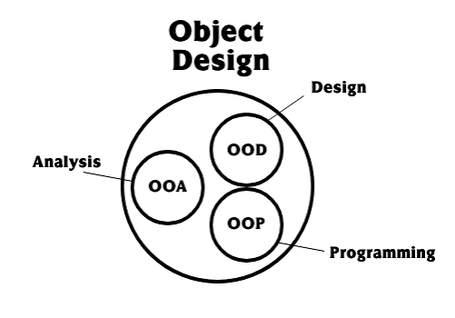
Object Oriented Analysis and Design Basic Concepts
Sandaruwani Pathirage
Lecturer (Probationary), FOT, UOR
MSc in Information Technology, University of Moratuwa
BSc in Management and Information Technology, University of Kelaniya

Slide 2
Learning Objectives
After completing this lecture, students should be able to:
Explain Object Orientation.
Describe the main principles of Object Orientation.
Explain the concept of a class.
Explain the concept of an object and instance.
Explain message passing between objects.
Explain high cohesion and low coupling.
Identify these concepts in a real-world software system.

Slide 3
2. System Development Life Cycle
Before understanding Object-Oriented Analysis and Design, we need to understand where analysis and design fit into software development.
A typical software development process includes:
Analysis → Design → Development → Testing → Deployment → Maintenance

Slide 4
Analysis
The goal is to understand:
What problem are we solving?
Who are the users?
What does the user actually need?
What should the system do?
Design
The system is planned before implementation.
During design, we decide:
Overall system architecture
Database structure
User interface
System flow
Components/modules
Technologies to be used
The design acts as a blueprint for development.
Development
The designed solution is implemented using a programming language and appropriate technologies.

Slide 5
Testing
The developed system is checked to determine whether it:
Works correctly
Satisfies requirements
Handles errors appropriately
Meets quality expectations
Deployment
The completed system is released for users.
Modern deployment may involve:
Cloud platforms
Containers
CI/CD pipelines
App stores
Web hosting
Maintenance
After deployment, the system may need:
Bug fixes
Security updates
Performance improvements
New features
Compatibility updates

Slide 6
Important: Modern software development is often iterative. Analysis, design, development and testing may happen repeatedly rather than only once in a strict sequence.

Slide 7
3. What is Object Orientation?
Basic Idea
Object Orientation (OO) is a way of thinking about and designing software as a collection of objects that interact with one another.
Instead of thinking only in terms of:
"What functions should the program perform?“
we also ask:
"What objects exist in this system, what do they know, what can they do, and how do they interact?"

Slide 8
In an object-oriented system:
Software is organized around objects.
Objects contain data.
Objects provide behavior.
Objects interact with other objects.
Objects may represent real-world entities, concepts, or software responsibilities.
For example, in a Library Management System, we may identify:
Book
Member
Librarian
Loan

Slide 9
Object Orientation is viewing a system as a set of interacting and interrelated objects, with each object encapsulating its data and behavior.

Slide 10
4. Objects as Self-Contained Components
An object can be considered a relatively self-contained software component.
An object:
1. Has its own data
Example:
Book
title
author
ISBN
availability
2. Has its own functionality
Example:
checkAvailability()
reserve()

Slide 11
3. Interacts with other objects
For example:
Member → borrows → Book
Advantages
Because responsibilities are organized into objects, components can potentially be:
Reused
Modified
Replaced
Tested independently

Slide 12
In today's software engineering, we usually think of objects as software abstractions rather than literally "real-world things." For example, PaymentService may be an object even though it is not a physical object.

Slide 13
5. OOA, OOD and OOP
These three terms are very important.
OOA — Object-Oriented Analysis
Question: What exists in the problem domain?
OOA focuses on identifying:
Objects
Concepts
Classes
Relationships
Requirements
We look at the problem from the perspective of the problem domain.
Example — Library System
We may identify:
Book
Member
Librarian
Loan
Library

Slide 14
OOD — Object-Oriented Design
Question: How should the software objects work together?
OOD takes the concepts identified during analysis and designs software structures that satisfy the requirements.
We determine:
Software classes
Attributes
Methods
Relationships
Object interactions
Responsibilities
Example:
Book
----------------
title
author
ISBN
----------------
checkAvailability()
reserve()

Slide 15
OOD focuses on defining software objects and how those objects collaborate to fulfill requirements.

Slide 16
OOP — Object-Oriented Programming
Question: How do we implement the design?
OOP is the implementation of object-oriented concepts using a programming language.
Examples of OO languages include:
Java
C#
C++
Python
Kotlin
Swift
TypeScript

Slide 17
OOP is the implementation/coding/construction stage of the designed objects.

Slide 18
Simple relationship
OOA
↓
Identify the problem-domain objects
OOD
↓
Design software objects and their interactions
OOP
↓
Implement those objects using a programming language

Slide 19
6. Traditional Development vs Object-Oriented Development
In a traditional approach, we often think primarily about:
Functions + Data
In OO development, we try to keep the:
Data + Behavior that operates on that data
together within appropriate objects/classes.
For example:
Instead of having:
customerData
calculateCustomerBill()
updateCustomer()
spread throughout the system
we may have:
Customer
----------------
name
address
balance
----------------
calculateBill()
updateDetails()
This is related to encapsulation.

Slide 20
OO development combines data/state and behavior/functions within objects and groups similar objects into classes.

Slide 21
9. Why Object Orientation?
Object-oriented development can provide several advantages:
1. Simplicity
Complex systems can be divided into understandable objects.
2. Reusability
Existing classes/components can potentially be reused.
3. Increased Quality
Modular designs can make testing and maintenance easier.
4. Faster Development
Reusable components can reduce development effort.

Slide 22
5. Maintainability
Changes can often be localized to particular classes/components.
6. Scalability
Large systems can be divided into smaller components.
7. Modularity
Each class can have a clear responsibility.
8. Modifiability
Well-designed systems can accommodate changes more easily.

Slide 23
Modern perspective
These benefits are strongest when OO design is combined with principles such as:
High cohesion
Low coupling
Single Responsibility
Composition
Dependency Injection
Interface-based design

Slide 24
7. What is an Object?
The concept of objects in programming has historical roots in languages such as Simula.
An object can be thought of as a software entity that:
Knows things
These are its attributes/state.
Does things
These are its methods/behavior.
For example:
Car Object
Knows:
Color
Manufacturer
Model
Cost
Owner
Can do:
Drive
Stop
Lock
Carry passengers

Slide 25
8. Attributes
An attribute represents a piece of data or property of an object.
Attributes describe the state of an object.
Example — Car
color
manufacturer
model
cost
owner
Different objects of the same class can have different attribute values.
For example:
Car 1
color = Red
model = Toyota
Car 2
color = Blue
model = Honda

Slide 26
9. Methods
A method represents what an object can do.
A method implements some behavior of the object.
Example — Car
drive()
stop()
lock()
openDoor()
Therefore:

Slide 27
Object | Attributes | Methods
Car | color, model, cost | drive(), stop()
Student | name, age, ID | study(), attendClass()
BankAccount | accountNo, balance | deposit(), withdraw()

Slide 28
10. State and Behavior
This is a very important distinction.
State
What the object is / knows at a particular time.
Represented by attributes.
Example:
Car
color = Red
manufacturer = Toyota
cost = 8,000,000
Behavior
What the object can do.
Represented by methods.
Example:
drive()
stop()
openDoor()
Easy way to remember
Attributes → What does it know?
Methods → What can it do?

Slide 29
11. Classes
A class is a blueprint/template used to describe a group of similar objects.
A class defines:
Attributes
Methods
Relationships
Common behavior
For example:
Employee
-------------------------
name
employeeID
salary
-------------------------
calculateSalary()
displayDetails()
The class does not represent one particular employee.
It describes what an Employee object should contain and what it can do.

Slide 30
Class is a template/description for objects that share common attributes, methods, operations and relationships.

Slide 31
12. Class vs Object
This is one of the most important concepts in OOAD.
Class
A blueprint/template.
Object
An actual instance created from the class.
Think about a house:
House Blueprint = Class
Actual House = Object
Example
Class: Employee
Possible objects:
employee1 → John
employee2 → Jane
employee3 → Mark
All belong to the Employee class but have different values.

Slide 32
13. Instance
An instance is a particular object created from a class.
Example:
Class:
Student
An instance:
Student
----------------
name = Peter
age = 15
----------------
study()
walk()
Peter is an instance of the Student class.
Each instance has its own state.

Slide 33
Instance is a single person, thing or concept in the application domain and another word for a single object.

Slide 34
14. Message Passing
Objects need to communicate with one another.
This communication is called message passing.
A message is essentially a request to an object to perform some operation.
For example:
Customer → placeOrder() → OrderService
The receiving object executes the appropriate method.

Slide 35

Simple analogy
A person says:
"Prepare the soup."
The chef receives the request and performs:
prepareSoup()
So:
Message → "Prepare soup"
Method → prepareSoup()

Slide 36
15. How Message Passing Works
There are normally three steps:
Step 1 — Sender
One object sends a message.
Step 2 — Receiver
Another object receives the message.
Step 3 — Method execution
The receiver executes the corresponding method.
A result may then be returned.
Sender
|
| message
↓
Receiver
|
| executes method
↓
Return value

Slide 37
Example:
lawrence.takeOrder(
"sofa",
"1 Robinson Rd",
120799
);
Here:
Object reference → lawrence
Method name → takeOrder
Parameters → "sofa", "1 Robinson Rd", 120799
16. Components of a Message
A message can contain:
1. Object reference
Identifies which object should receive the message.
2. Method name
Identifies what operation should be performed.
3. Parameters
Provide the required input values.

Slide 38
17. Client and Server Objects
In object interaction:
Message Sender
Acts as the client.
Message Receiver
Acts as the server for that particular request.
Example:
Customer
|
| placeOrder()
↓
SalesPerson
The Customer requests a service.
The SalesPerson provides the service.
Alex is the customer/client and Lawrence is the receiving/server object.

Slide 39
18. Method Signature
A method has a signature that identifies the operation.
For example:
getMyFundsFromBank(String bankName)
The signature concept focuses on:
Method name
Parameter list
For example:
getMyFundsFromBank(String)
Different programming languages define the exact rules for what constitutes a method signature.
The original lecture specifically explains the signature as the combination of method name and parameter list.

Slide 40
19. Principles of Object Orientation
There are four major principles:
Abstraction
Encapsulation
Inheritance
Polymorphism
These are often called the four pillars of OOP.

Slide 41
Real-World Example — Map
A map is an abstraction.
Different maps show different information depending on the purpose.
Road map
Shows:
Roads
Cities
Routes
Distances
Geological map
Shows:
Rock types
Geological structures
Geological boundaries
The same geographical area can be represented differently depending on what information is important.
20. Abstraction
Definition
Abstraction means focusing on the important aspects of something while ignoring unnecessary details.
It answers:
What does this object do?
rather than:
How exactly does it do it?

Slide 42
20. Software Example of Abstraction
Consider a smartphone call.
The user sees:
Incoming Call
[ Accept ] [ Reject ]
The user does not need to know:
How the network identifies the phone
How signalling works
How audio packets are transmitted
How the operating system manages the call
How the network establishes the connection

Slide 43
The complexity is hidden.
The user interacts with a simple interface.
Therefore:
Abstraction hides unnecessary complexity and exposes the essential functionality.

Slide 44
For example:
BankAccount
-------------------------
private balance
private accountNumber
-------------------------
deposit()
withdraw()
getBalance()
Outside code should not normally manipulate balance directly.
Instead:
deposit()
withdraw()
control how the balance changes.
21. Encapsulation
Definition
Encapsulation means packaging data and the operations that work on that data together inside an object/class.
It also involves controlling access to the object's internal state.

Slide 45
22. Data Hiding
Data hiding means restricting direct access to internal data or implementation details.
For example:
private double balance;
Instead of:
account.balance = -500000;
we provide controlled operations:
account.deposit(5000);
account.withdraw(1000);

Slide 46
This allows the class to enforce rules.
For example:
withdraw(amount)
if amount <= balance
perform withdrawal
else
reject transaction

Slide 47
Encapsulation is separating an object's external interface from its hidden internal implementation.

Slide 48
23. Advantages of Encapsulation
1. Data Integrity
Data can only be modified through controlled operations.
2. Security
Sensitive internal information can be protected.
3. Control
The class decides which operations are allowed.
4. Flexibility
Internal implementation can change without necessarily affecting users of the class.
5. Reduced Complexity
Users do not need to understand internal implementation

Slide 49
24. Encapsulation vs Abstraction
Encapsulation
Focuses on:
How do we package and protect the data and implementation?
Abstraction
Focuses on:
What should we expose and what unnecessary complexity should we hide?

Slide 50
Bank Account Example
BankAccount
------------------------
private balance
------------------------
deposit()
withdraw()
getBalance()
Encapsulation
balance is protected from direct access.
Abstraction
The user only needs to know:
deposit()
withdraw()
getBalance()
They do not need to know exactly how the bank internally updates the balance.

Slide 51
25. Inheritance
Inheritance is a relationship between classes where one class derives from another class.
The existing class is usually called:
Parent
Base
Superclass
The new class is called:
Child
Derived
Subclass
Example:
Vehicle
|
-------------------
| | |
Car Bike Truck
The child classes can inherit common attributes and behavior from Vehicle.

Slide 52
Inheritance is a mechanism for sharing and reusing attributes and behaviors.

Slide 53
26. Why Use Inheritance?
Suppose:
Car
Bike
Truck
all have:
vehicleNumber
brand
speed
start()
stop()

Slide 54
Instead of repeating these in every class:
Vehicle
----------------
vehicleNumber
brand
speed
----------------
start()
stop()
Then:
Car extends Vehicle
Bike extends Vehicle
Truck extends Vehicle
The common functionality can be reused.

Slide 55
Inheritance is useful when there is a genuine "is-a" relationship.
For example:
A Car is a Vehicle.
However, modern OO design often prefers composition over inheritance
when appropriate, because excessive inheritance can create rigid class hierarchies

Slide 56
27. Polymorphism
The word polymorphism means:
Many forms
Poly = many
Morph = form
In OO systems, polymorphism allows the same operation/interface to produce different behavior depending on the object involved.

Slide 57
Better Example of Polymorphism
Consider:
Vehicle
|
-------------------
| | |
Car Bike Truck
Suppose every vehicle has:
calculateParkingFee()
A Car may calculate the fee one way.
A Bike may calculate it another way.
A Truck may calculate it differently.
The caller can use the same operation:
vehicle.calculateParkingFee()
but the behavior depends on the actual vehicle type.
This is polymorphism.

Slide 58
Modern Example — Payment
Consider:
Payment
|
---------------------------
| | |
Card PayPal BankTransfer
Each payment type can implement:
pay()
The application can call:
payment.pay()
without needing to know the detailed implementation.

Slide 59
28. Cohesion and Coupling
Two very important OO design concepts are:
Cohesion
How closely related the responsibilities inside a module/class are.
Coupling
How strongly one module/class depends on another.
A good OO design generally aims for:
High Cohesion + Low Coupling
Cohesion and coupling are measures of relationships within and between software modules.

Slide 60
29. Cohesion
What is Cohesion?
Cohesion measures how strongly the responsibilities, methods and data of a class belong together around a single meaningful purpose.
High cohesion
A class has a clear and focused responsibility.
Example:
EmailService
----------------
validateEmail()
sendEmail()
formatEmail()
These operations are related.
Therefore:
High cohesion = focused class with closely related responsibilities

Slide 61
Low Cohesion
Consider:
UserManager
----------------
createUser()
deleteUser()
validateEmail()
sendWelcomeEmail()
generateReport()
printReport()
calculateTax()
playMusic()
This class is doing too many unrelated things.
It has low cohesion.
We could separate it into:
UserService
EmailService
ReportService
TaxService
MusicService

Slide 62
"Does this class have one clear purpose?"
If YES:
High Cohesion
If NO:
Low Cohesion

Slide 63
Example
StudentService
responsible for:
registerStudent()
updateStudent()
removeStudent()
→ High cohesion.
But:
StudentService
printInvoice()
sendEmail()
calculateSalary()
playVideo()
→ Low cohesion.

Slide 64
30. Coupling
What is Coupling?
Coupling refers to the degree of dependency between software modules/classes.
If two classes depend heavily on each other:
→ High coupling
If they are relatively independent:
→ Low coupling
Coupling is the degree of interdependence and strength of connections

Slide 65
High Coupling
Imagine:
Class A
↓
Class B
↓
Class C
↓
Class D
If changing Class B requires changes in A, C and D, the system is highly dependent.
This makes the system:
Difficult to maintain
Difficult to test
Difficult to modify
More vulnerable to changes

Slide 66
Low Coupling
In a loosely coupled system:
Class A → Interface ← Class B
Classes depend less directly on implementation details.
Advantages include:
Easier maintenance
Easier testing
Easier replacement
Easier modification
Better flexibility

Slide 67
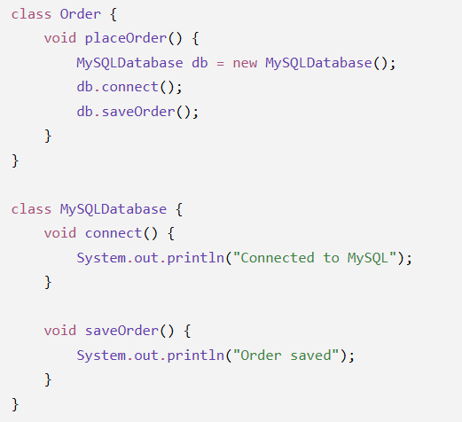
Example: Online Order System
Here, Order is directly dependent on MySQLDatabase.
If we change from MySQL to MongoDB:
Order
↓
MySQLDatabase
We have to modify the Order class.
➡️ High coupling

Slide 68
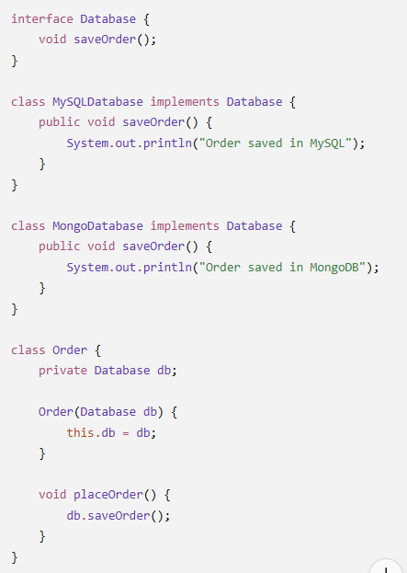
Loose Coupling 🟢
Loose coupling means classes depend on an abstraction/interface, rather than a specific implementation.
┌── MySQLDatabase
Order → Database
└── MongoDatabase
The Order class doesn't care which database is being used.

Slide 69
Real-world analogy:
🔴 High coupling → A phone charger that works only with one specific phone model.
🟢 Loose coupling → A USB-C standard charger that can work with many compatible devices.

Slide 70
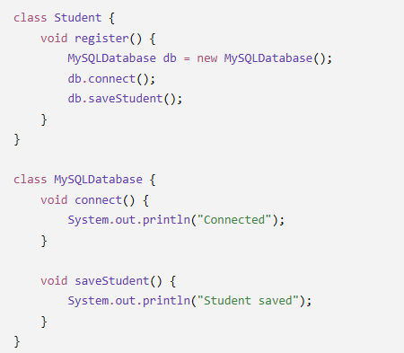
Is this high coupling or loose coupling? Why?

Slide 71
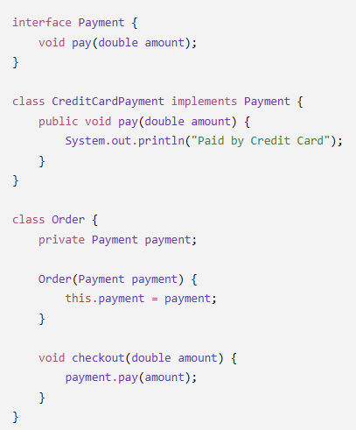
Is this high coupling or loose coupling? Why?

Slide 72
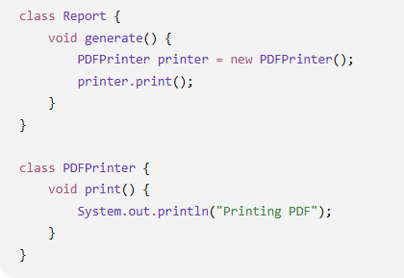
Is this high coupling or loose coupling? Why?

Slide 73
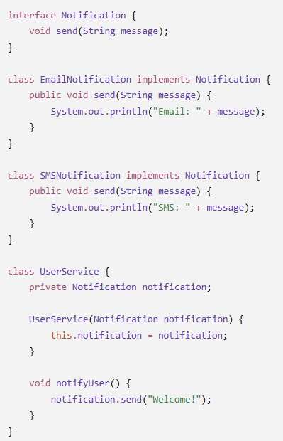
Is this high coupling or loose coupling? Why?

Slide 74
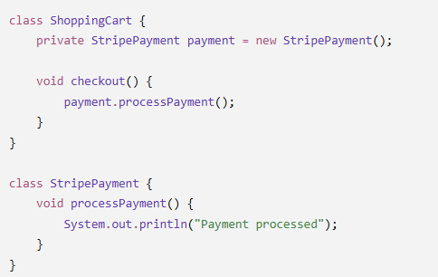
Is this high coupling or loose coupling? Why?

Slide 75
31. Cohesion vs Coupling
Remember:
High Cohesion + Low Coupling = Good OO Design
Cohesion | Coupling
Concerned with one class/module | Concerned with relationships between classes/modules
Measures internal relatedness | Measures external dependency
We want high cohesion | We want low coupling
One clear responsibility | Minimal unnecessary dependency

